Slide 1
Amjad Ali-
Flight Price Prediction

Slide 2
Flight-Price-Prediction
Created a tool that estimates Flight Prices to help users look for best prices when booking flight tickets.
Engineered features from the Departure Time, Date of Journey, to quantify the data and make it more understandable.
Optimized multiple Regression models using GridsearchCV to reach the best model.

Slide 3
Codes and Resources Used
Python Version: 3.8.5
Packages: pandas, numpy, sklearn, matplotlib, seaborn, flask, json, pickle
For Web Framework Requirements: pip install -r requirements.txt
Dataset: https://www.kaggle.com/nikhilmittal/flight-fare-prediction-mh
Flask Productionization: https://towardsdatascience.com/productionize-a-machine-learning-model-with-flask-and-heroku-8201260503d2

Slide 4
Problem Statement
Flight ticket prices can be something hard to guess, today we might see a price, check out the price of the same flight tomorrow, it will be a different story. We might have often heard travelers saying that flight ticket prices are so unpredictable. As data scientists, we are gonna prove that given the right data anything can be predicted. Here you will be provided with prices of flight tickets for various airlines between the months of March and June of 2019 and between various cities. Size of training set: 10683 records
Size of test set: 2671 records
FEATURES: Airline: The name of the airline.
Date_of_Journey: The date of the journey
Source: The source from which the service begins.
Destination: The destination where the service ends.

Slide 5
Route: The route taken by the flight to reach the destination.
Dep_Time: The time when the journey starts from the source.
Arrival_Time: Time of arrival at the destination.
Duration: Total duration of the flight.
Total_Stops: Total stops between the source and destination.
Additional_Info: Additional information about the flight
Price: The price of the ticket

Slide 6
Cleaning the Data
I needed to clean it up so that it was usable for our model. I made the following changes and created the following variables:
Made Columns for Day and Month out of Date of Journey
Calculated the total flight duration
Removed the null values
Removed the outliers

Slide 7
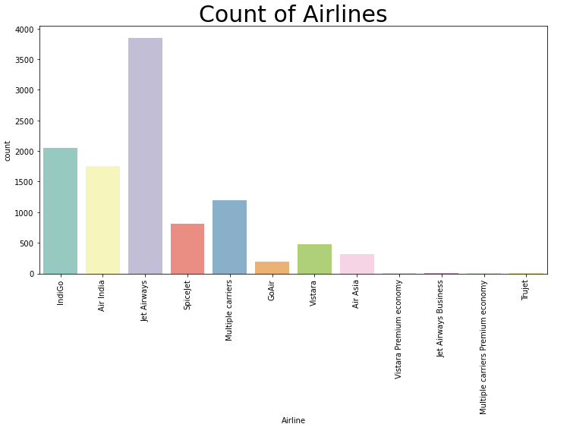
EDA

Slide 8
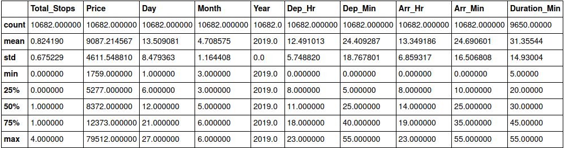

Slide 9
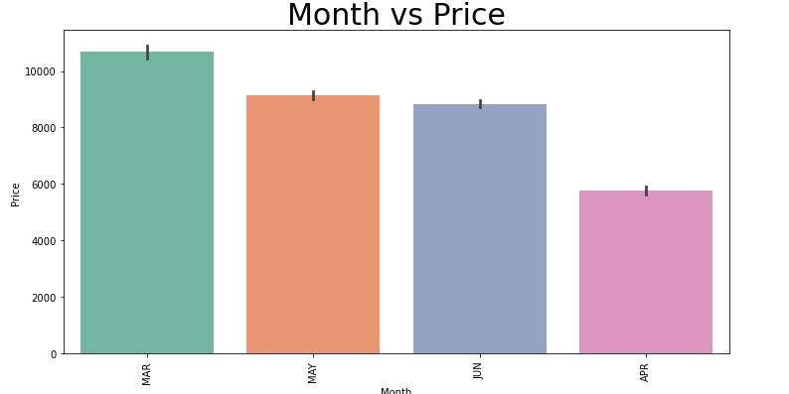

Slide 10
Model Building
First, I transformed the categorical variables into dummy variables. I also split the data into train and tests sets with a test size of 30%.
I tried forteen different models and evaluated them using Root Mean Squared Error.
I chose RMSE because it is relatively easy to interpret and outliers aren’t particularly bad in for this type of model.
Different models I tried:

Slide 11
LinearRegression : 2779.0455708889144
ElasticNet : 3379.6819876610443
Lasso : 2759.449381312224
Ridge : 2710.8476127741037
KNeighborsRegressor : 3249.005561971264
DecisionTreeRegressor : 2017.530360334335
RandomForestRegressor : 1662.7359733973055
SVR : 4246.460099935076

Slide 12
AdaBoostRegressor : 3135.985374101527
GradientBoostingRegressor : 1904.7364927923986
ExtraTreeRegressor : 2432.1393735590073
HuberRegressor : 3108.870789540331
XGBRegressor : 1603.7426369307445
BayesianRidge : 2773.275561516677
XGBRegressor, RandomForestRegressor and GradientBoostingRegressor gave the lowest RMSE so I chose these model and performed hyper parameter tuning

Slide 13
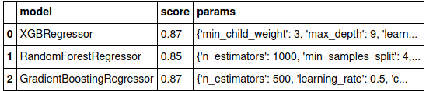
USing hyperparameter tuning on GradientBoostingRegressor further increased the accuracy.

Slide 14
Model Accuracy
GradientBoostingRegressor :
MAE: 959.8979539240587
MSE: 2705023.0432436923
RMSE: 1644.6954256772565

